Slide 1
IACS Industrial Academia Coordination system GROUP MEMBERS Muhammad Khalid SE-018 Muhammad Waqar SE-050
Internal supervisor:
Dr. Sh. Muhammad Wahab Uddin Usmani
Industrial advisor:
Hasnain Tayyab
Software Engineering Department
NED University of Engineering and Technology, Karachi

Slide 2
Contents
Project Overview
Why IACS?
Project Features Vs Projects boundaries
Use case diagram
Project Milestones and Tasks
Work Distribution
Project Schedule
Project Achievements
Gantt chart

Slide 3
Project Overview
IACS
It is a platform to provide the coordination between university students and respective industries.
Job: Students can avail jobs or can be request for their relative jobs.
Internship: Students can find the internship with in the university.
Training: Software house can provides training to the interested candidates.
Scholarship: It is easy for student to find the scholarships without any hustle.
Project Providence & Funding: Industry can present their project idea and hire students in their project or Student can apply for their project funding.
Donations: Most of the students require laptops for their study, so Industry can help those students through IACS.

Slide 4
Why IACS?
Our project is specially for academy.
Most of the commercial platform like LinkedIn, Rozee.pk, Indeed… they operate commercially only not for academy.
Different platform provide different service like jobs, internships scholarships, training and donations. For example Indeed only provide jobs.
IACS will fulfill those requirements.

Slide 5
Project Boundaries
Project Features
Jobs
Internships
Scholarship
Project Idea
Jobs
Internships
Scholarship
Trainings
Donations
Project Funding
Project Idea

Slide 6
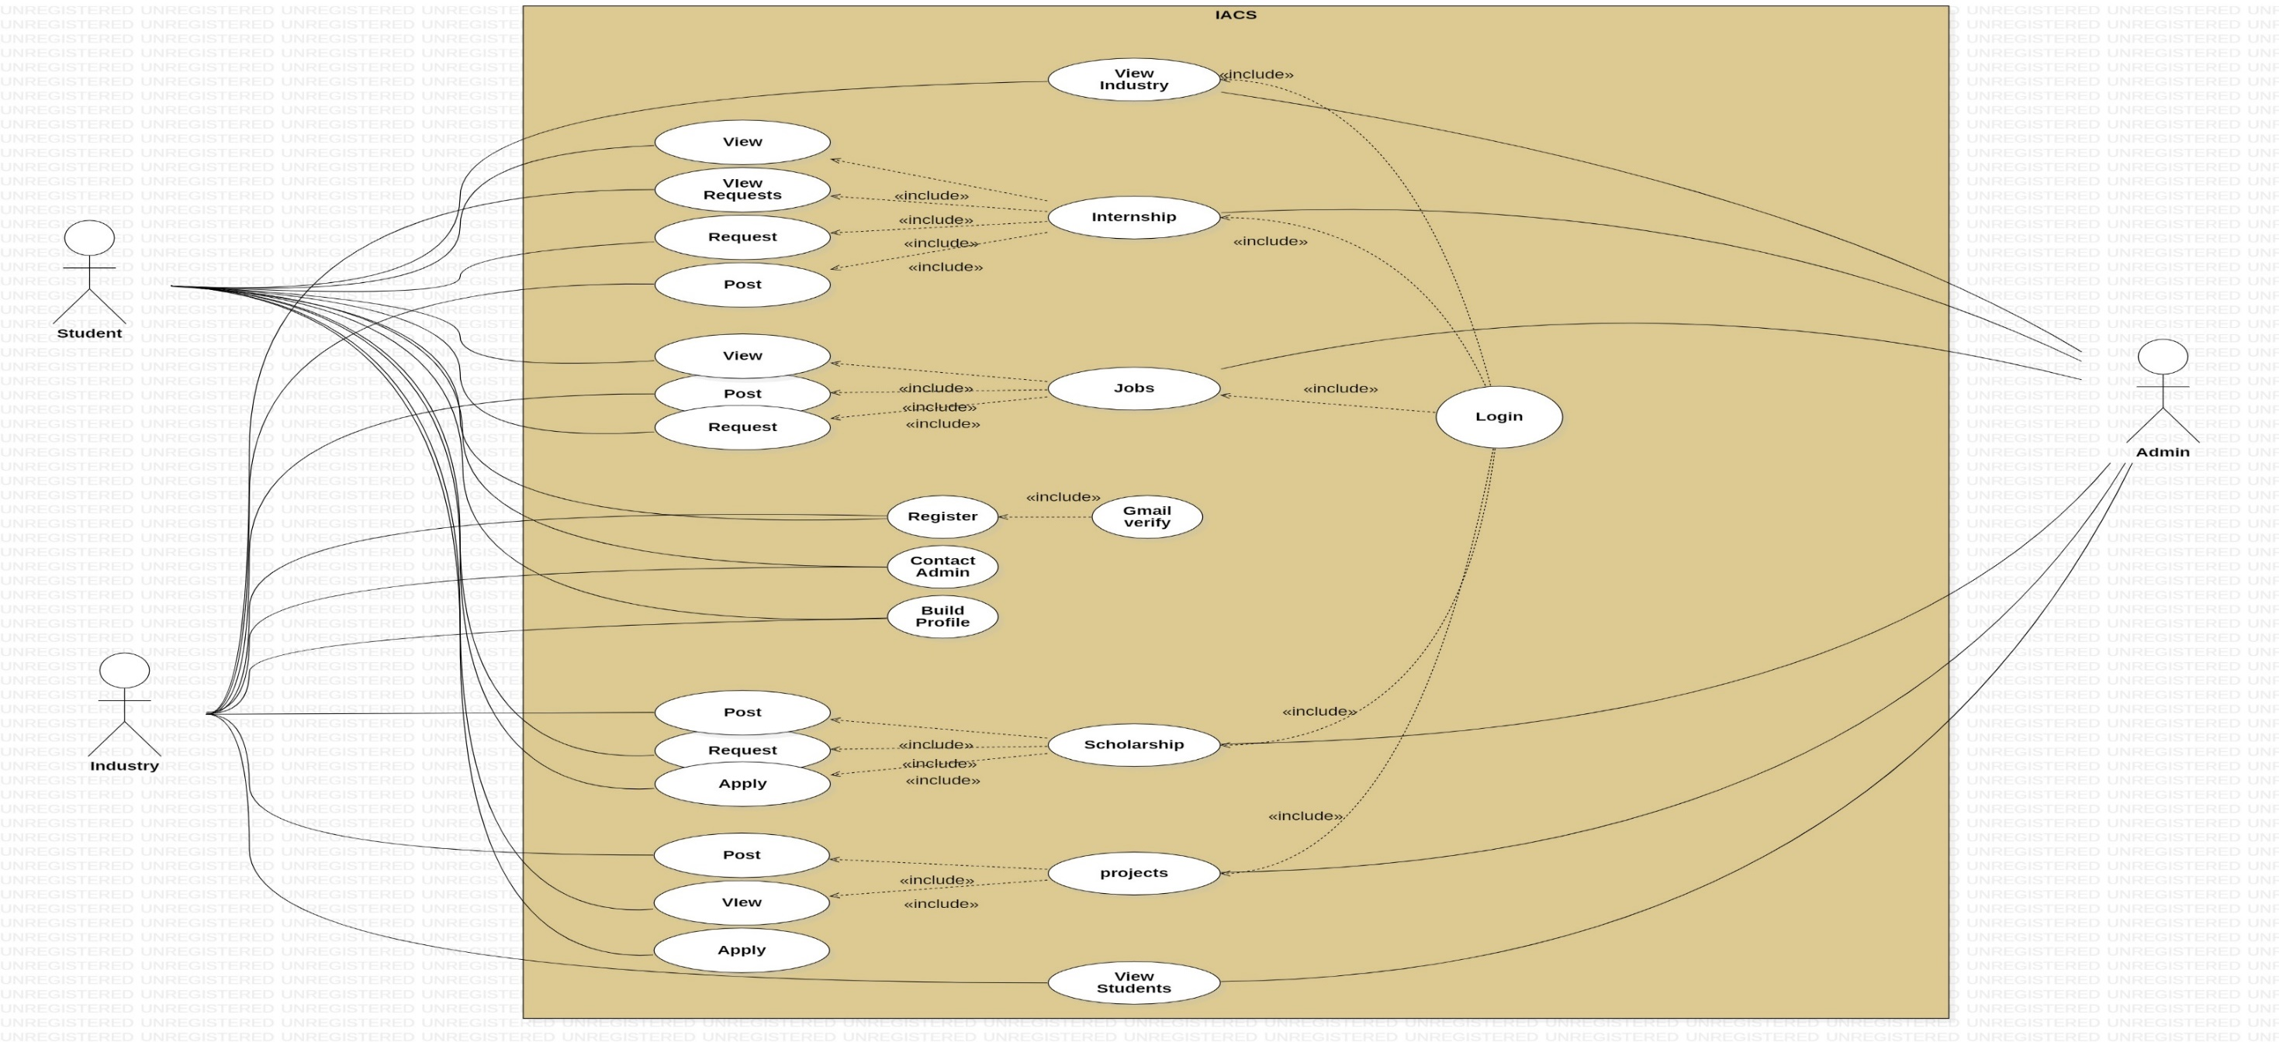
Use case diagram

Slide 7
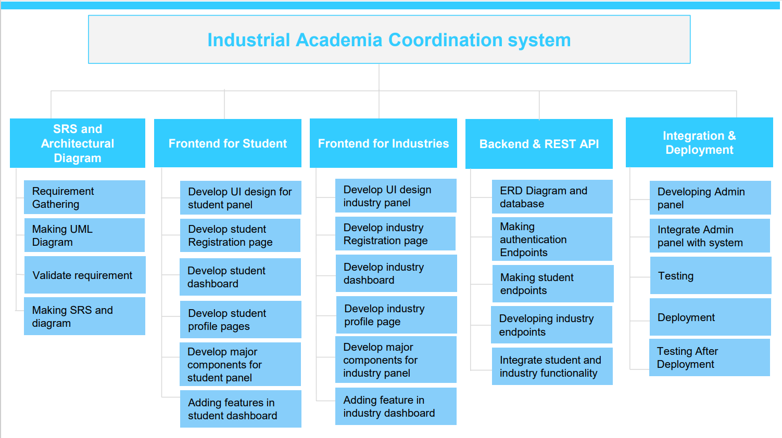
Project Milestones and Tasks

Slide 8
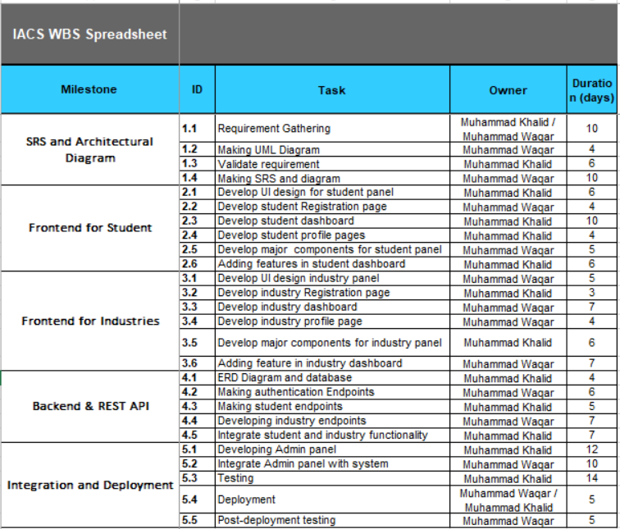
Work Distribution

Slide 9
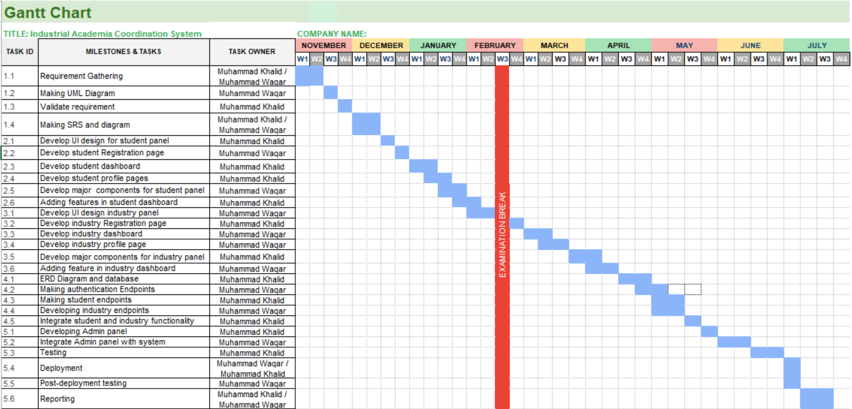
Project Schedule

Slide 10
Project Achievements
Requirement Gathering
SRS
UML Diagrams
Student Dashboard
Authentication and Authorization API
Features of dashboard
Industry panel and it major components

Slide 11
Remaining work
ERD
API for remaining features (Post and request job, internships, scholarships…)
API Integration
Testing
Deployment
Reporting compilations

Slide 12
QUESTION AND ANSWER

